Slide 1


ASP .NET CORE
WEB DEVELOPMENT
Notes:
Introduction to asp,net core web development
"Hey everyone, are you excited to dive into the world of modern web development?" Today, we'll explore what ASP.NET Core web development is, why it's awesome, and how you can get started building amazing web applications with it.

Slide 2

Overview
What is ASP.Net Core
History and Evolution of ASP.Net core
Asp.Net core web development Architecture
Basic Asp.net core Web development project structure
Notes:
in this session we are going to discuss about
what is Asp.net Core .
And what is its history ,
what is asp.net core architecture
And
what is basic asp.net core web development project structure
so lets start...

Slide 3

What is Asp.Net core
ASP.NET Core is a cross-platform, open-source web framework for building modern web applications.
It was developed by Microsoft and first released in 2016.
ASP.NET Core offers a high-performance, modular architecture that is designed to be lightweight and scalable.
It supports multiple programming languages, including C#, F#, and Visual Basic.
ASP.NET Core includes built-in for cloud-based deployments and microservices architecture.
Notes:
What is asp.net core
"Imagine building web applications and APIs that run smoothly on any platform, Windows, Mac, or Linux. That's the power of ASP.NET Core!"
ASP.NET Core stands as a versatile, open-source web framework crafted by Microsoft, making waves since its initial release in 2016.
This framework redefines web application development with its cross-platform capabilities and high-performance, modular design.
At its core, ASP.NET Core is engineered to be lightweight yet scalable, accommodating modern application demands. Its compatibility with various programming languages like C#, F#, and Visual Basic ensures flexibility for developers. Notably, ASP.NET Core comes equipped with features tailored for cloud-based deployments and the ever-evolving microservices architecture, making it a favored choice for building robust, efficient web applications.

Slide 4

What is Asp.Net core
It offers a range of features for building web applications, including model binding, routing, middleware, and dependency injection.
ASP.NET Core integrates with a range of front-end frameworks and libraries, including React, Angular, and Vue.js.
It offers built-in support for security, including authentication and authorization.
ASP.NET Core is constantly evolving, with regular updates and new features being added.
It is widely used in industry, with many large companies and organizations adopting it for their web development projects.
Notes:
ASP.NET Core is a comprehensive web framework that offers a rich set of features tailored for building modern web applications.
With functionalities such as model binding, routing, middleware, and dependency injection, developers can create applications with streamlined data handling, efficient navigation, and enhanced flexibility.
This framework seamlessly integrates with popular front-end frameworks like React, Angular, and Vue.js, enabling the development of dynamic Single Page Applications (SPAs) with ease.
Security is a top priority, as ASP.NET Core provides built-in support for authentication and authorization, empowering developers to implement robust security measures effortlessly.
Constantly evolving, ASP.NET Core receives regular updates and introduces new features to stay abreast of industry trends, ensuring developers have access to cutting-edge tools.
Its widespread adoption in the industry, favored by large companies and organizations, speaks to its reliability, scalability, and extensive feature set. ASP.NET Core stands as an industry standard, helping businesses efficiently build scalable, secure web applications that meet the demands of modern web development.

Slide 5
History
1
1.11
2.0
2.1
2.2
3.0
3.1
3.0
3.1
5
6
7
2016-06-27
2016-06-27
2016-06-27
2018-05-30
2018-12-04
2016-06-27
2018-12-04
2016-06-27
2020-11-10
2020-11-10
2021-11-08
2022-11-08
Notes:
here we are taking a journey through the evolution of the ASP.NET Core frameworks. We begin in June 2016 with version 1, marked by its initial release. It was a significant milestone that laid the foundation for future developments.
Moving forward to July of the same year, version 1.1.0 was introduced with enhanced features and improvements addressing the feedback from the initial release.
In March 2018, we witnessed another leap with version 2.0 and then quickly to 2.1 in May, each bringing more refined features and performance enhancements.
The timeline continues with versions up to 3.1 released in December of 2019 which included significant updates and added functionalities making ASP.NET Core more robust and efficient.
We then transitioned into .NET 5 era in November 2020 marking a departure from the core branding but continuing the legacy of innovation and improvement.
The journey doesn’t end there; .NET 6 arrived in November 2021 introducing new set of capabilities enhancing developer experience and application performance.
.NET 8 is the current latest version till 2024 And it is realesed in November 2023, further advancements.

Slide 6
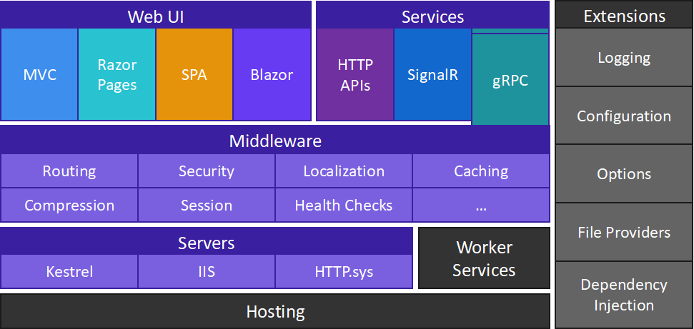
Architecture
Notes:
Now Lets explore the intricate architecture of ASP.NET Core frameworks. As you can see, it is meticulously structured to enhance performance and flexibility.
Starting with the Web UI section, we have MVC for model-view-controller architecture ensuring separation of internal representations of information from user interfaces. Razor Pages simplifies the building of UI, and SPA (Single Page Applications) ensures a more reactive user experience.
Moving to Services, Blazor allows us to build interactive web UIs using C# instead of JavaScript. HTTP APIs facilitate data communication and interaction while SignalR ensures real-time web functionality.
In Middleware, we have various components like Routing for URL mapping, Security for authentication & authorization, Localization for language preference settings among others ensuring that requests are processed effectively.
The Servers section highlights Kestrel and IIS offering cross-platform flexibility and robust performance respectively; HTTP.sys is tailored for Windows-based environments.
Worker Services in Hosting ensure background service execution while Extensions like Logging provide insights into application behavior; Configuration facilitates option settings management; Dependency Injection supports runtime code configuration enhancing modularity and testability.

Slide 7

Web UI Components
MVC
Razor Pages
Single Page Apps (SPA)
Blazor
Notes:
Web UI Components
Web UI Components in .NET Core provide a powerful toolkit for creating interactive and responsive user interfaces.
With frameworks like ASP.NET Core MVC, Razor Pages and Blazor, developers can build modern web applications with ease.
lets look into that deeply

Slide 8

ASP .NET Core Razor Pages
Razor Pages is a page-based model.
UI and business logic concerns are kept separate, but within the page.
Razor Pages is the recommended way to create new page-based or form-based apps for developers new to ASP.NET Core.
Razor Pages provides an easier starting point than ASP.NET Core MVC.
Notes:
ASP .NET Core Razor Pages
lets deep dive into the world of ASP.NET Core Razor Pages...
As you can see, Razor Pages is a page-based model that simplifies the architecture of web development in ASP.NET Core. It ensures that UI and business logic concerns are kept separate yet within the same page for enhanced readability and maintenance.
Razor Pages is highly recommended for those venturing into ASP.NET Core development as it provides an easier starting point than ASP.NET Core MVC. It’s intuitive, straightforward, and efficient in creating new page-based or form-based apps.
The illustration to your right visually represents a developer engaging with Razor Pages on a laptop, symbolizing its user-friendly interface and streamlined coding process. Each line of code is meticulously crafted to ensure optimal performance and responsiveness for every web application developed under this model.

Slide 9

ASP .NET Core MVC
ASP.NET MVC renders UI on the server and uses a Model-View-Controller (MVC) architectural pattern.
The MVC pattern separates an app into three main groups of components: Models, Views, and Controllers.
User requests are routed to a controller. The controller is responsible for working with the model to perform user actions or retrieve results of queries.
The controller chooses the view to display to the user, and provides it with any model data it requires. Support for Razor Pages is built on ASP.NET Core MVC.
Notes:
ASP.NET Core MVC.
As you can see, ASP.NET MVC is instrumental in rendering UI on the server and employs a Model-View-Controller architectural pattern. This pattern is pivotal as it organizes an application into three interconnected components: Models, Views, and Controllers.
Each component plays a distinct role; Models represent the data layer, Views display the user interface and user experience layers, while Controllers handle the business logic. In essence, user requests are directed to a Controller which then collaborates with the Model to execute these requests and generate results.
The Controller is not just about processing requests; it’s also tasked with selecting an appropriate View to render responses effectively. It ensures that Views have access to any model data they require for optimal presentation.
We should also highlight that ASP.NET Core MVC extends support for Razor Pages – a feature that simplifies web UI development while maintaining the benefits of ASP.NET Core architecture. With this synergy of components and features, developers can create efficient, scalable, and maintainable web applications.

Slide 10
Blazor Server
Blazor is a framework for building interactive client-side web UI with .net
Create rich interactive UIs using C# instead of Javacript.
Share server-side and client-side app logic written in .NET.
Render the UI as HTML and CSS for wide browser support, including mobile browsers.
Integrate with modern hosting platforms, such as Docker.
Build hybrid desktop and mobile apps with .NET and Blazor.
Notes:
ASP.NET Core Blazor.
As depicted, Blazor is a robust framework tailored for building interactive client-side web UI with .NET, eliminating the need for Javascript. This innovation allows developers to create rich user interfaces utilizing C#, enhancing consistency and efficiency.
Moving forward, we highlight the capability of sharing server-side and client-side app logic written in .NET. This feature fosters a seamless integration between client and server operations, enhancing real-time responsiveness and user experience.
In terms of rendering, Blazor Server is engineered to render the UI as HTML and CSS for wide browser support, including mobile browsers. This ensures that applications are accessible across a diverse range of devices without compromising functionality or aesthetic appeal.
Integration is also a pivotal aspect; Blazor Server can be integrated with modern hosting platforms such as Docker. This compatibility amplifies deployment flexibility and scalability options for your applications.
Lastly, we underscore the ability to build hybrid desktop and mobile apps with .NET and Blazor. This adaptability ensures that developers can create versatile applications that are not only efficient but also tailored to meet diverse user needs across various platforms.

Slide 11
Single Page Applications (SPA)
Single Page Application (SPA) is a type of web application that loads a single HTML page and dynamically updates the content as the user interacts with the page.
ASP.NET Core SPA is a framework for building SPA applications using ASP.NET Core. It includes several tools and libraries for building modern web applications, including client-side libraries, server-side APIs, and middleware components.
ASP.NET Core SPA applications typically use a client-side JavaScript framework such as Angular, React, or Vue.js to handle the user interface and application logic.
The server-side component of the ASP.NET Core SPA application provides APIs and services for interacting with data, managing authentication and authorization, and performing other server-side tasks.
Notes:
In today’s web development landscape, Single Page Applications (SPA) represent a paradigm shift towards more interactive and responsive user experiences. This slide introduces SPAs as web applications that load a single HTML page and dynamically update content based on user interactions, without the traditional page refresh.
Single Page Application (SPA) is a type of web application that loads a single HTML page and dynamically updates the content as the user interacts with the page.
ASP.NET Core SPA is a framework for building SPA applications using ASP.NET Core. It includes several tools and libraries for building modern web applications, including client-side libraries, server-side APIs, and middleware components.
ASP.NET Core SPA applications typically use a client-side JavaScript framework such as Angular, React, or Vue.js to handle the user interface and application logic.
The server-side component of the ASP.NET Core SPA application provides APIs and services for interacting with data, managing authentication and authorization, and performing other server-side tasks.

Slide 12

Services
HTTP APIs
SignalR
gRPC
Notes:
ASP.NET Core is a versatile and high-performance framework designed to build modern, cloud-based, internet-connected applications. One of its strengths lies in the variety of services it provides, which are essential for developing robust web applications and services. This slide highlights three key services offered by ASP.NET Core:
HTTP APIs
SignalR
gRPC
These services are integral to ASP.NET Core’s ability to deliver high-quality web applications and services. They ensure that developers have the tools necessary to build applications that are not only functional but also conform to modern standards of performance and user engagement.

Slide 13
HTTP APIs
HTTP APIs are a common way of building RESTful services using HTTP as the underlying protocol.
ASP.NET Core provides built-in support for building HTTP APIs using the MVC framework, which includes controllers, actions, and routes for handling incoming requests and returning responses.
Notes:
HTTP APIs
HTTP APIs are a common way of building RESTful services using HTTP as the underlying protocol.
ASP.NET Core provides built-in support for building HTTP APIs using the MVC framework, which includes controllers, actions, and routes for handling incoming requests and returning responses.

Slide 14


SignalR
SignalR is a real-time communication library that enables bidirectional communication between clients and servers using WebSockets,.Server-Sent Events, or other transport protocols.
ASP.NET Core includes built-in support for building SignalR applications, which can be used for building real-time applications such as chat applications, collaborative editing tools, and online gaming applications.
Notes:
SignalR
SignalR is a real-time communication library that enables bidirectional communication between clients and servers using WebSockets,.Server-Sent Events, or other transport protocols.
ASP.NET Core includes built-in support for building SignalR applications, which can be used for building real-time applications such as chat applications, collaborative editing tools, and online gaming applications.

Slide 15
gRPC
gRPC is a high-performance remote procedure call (RPC) framework developed by Google.
ASP.NET Core includes built-in support for building gRPC services, which can be used for building high-performance distributed systems using a variety of programming languages and platforms.
Notes:
gRPC
gRPC is a high-performance remote procedure call (RPC) framework developed by Google.
ASP.NET Core includes built-in support for building gRPC services, which can be used for building high-performance distributed systems using a variety of programming languages and platforms.

Slide 16
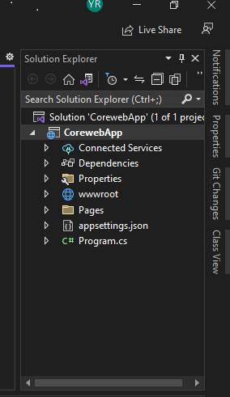
Basic Structure
Notes:
Basic Structure
The slide presents a clear view of the fundamental architecture of an ASP.NET Core web application, showcasing the essential components that make up the project’s skeleton in Visual Studio’s Solution Explorer. The structure is meticulously organized to facilitate the development and maintenance of the application, with each element serving a specific purpose:
Dependencies: A crucial folder that contains all the NuGet packages, libraries, and other dependencies that the application relies on. It ensures that all necessary components are available for the application to function correctly.
Properties: This folder houses the application’s settings and configurations, such as the launchSettings.json file, which configures the environment for development and testing.
wwwroot: The wwwroot directory is the root of the web server and contains static files like CSS, JavaScript, and images. It’s accessible to the public and plays a vital role in defining the look and feel of the application.
Pages: In the context of Razor Pages applications, this folder holds the Razor pages, which are a combination of HTML markup with C# code, enabling server-side page generation before sending the HTML to the client.
appsettings.json: A JSON file that stores configuration data, such as connection strings and application settings. It’s a central place to manage the settings that the application can read at runtime.
Program.cs: The entry point of the application, containing the Main method. It sets up the web host and starts listening for incoming HTTP requests.
Understanding this structure is vital for developers as it provides the framework within which they can build and expand their web applications. Each file and folder has its designated role, contributing to the overall functionality and performance of the application.

Slide 17
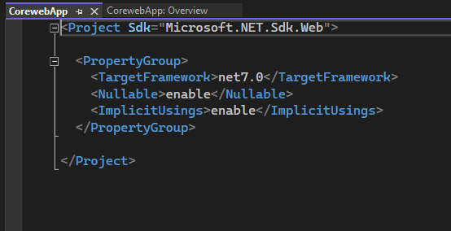
.csproj file
Notes:
A .csproj file is a C# project file that contains a list of files and references to system assemblies in a project. Visual Studio automatically generates and saves these files when a project is created.

Slide 18
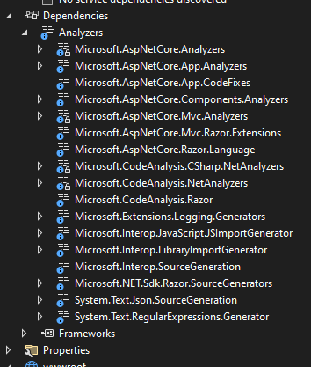
Dependencies
The Dependencies node contains all the references of the NuGet packages used in the project. Here the Frameworks node contains reference two most important dotnet core runtime and asp.net core runtime libraries. Project contains all the installed server-side NuGet packages
Notes:
Dependencies
dependencies is A crucial folder that contains all the NuGet packages, libraries, and other dependencies that the application relies on. It ensures that all necessary components are available for the application to function correctly.
Here the Frameworks node contains reference two most important dotnet core runtime and asp.net core runtime libraries. Project contains all the installed server-side NuGet packages

Slide 19
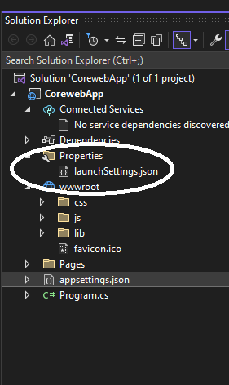
Properties
Properties folder contains a launchSettings.json file, which containing all the information required to launch the application. Configuration details about what action to perform when the application is executed and contains details like IIS settings, application URLs, authentication, SSL port details, etc.
Notes:
Properties
Properties folder contains a launchSettings.json file, which containing all the information required to lunch the application. Configuration details about what action to perform when the application is executed and contains details like IIS settings, application URLs, authentication, SSL port details, etc.

Slide 20
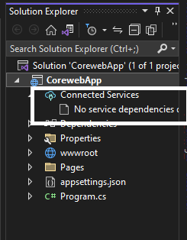
Connected Services
It contains the details about all the service references added to the project. A new service can be added here, for example, if you want to add access to Cloud Storage of Azure Storage you can add the service here.
Notes:
Connected Services
It contains the details about all the service references added to the project. A new service can be added here,
for example,
if you want to add access to Cloud Storage of Azure Storage you can add the service here.

Slide 21
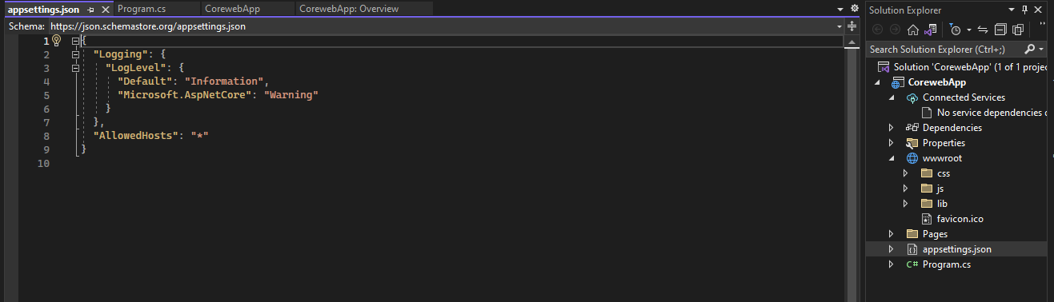
appsettings.json
This file contains the application settings, for example, configuration details like logging details, database connection details.
Notes:
appsettings.json
In .NET Core, the appsettings.json file is a configuration file that stores settings for an application. It's a JSON file that contains key-value pairs to configure the behavior of an application. Settings can include database connection strings, logging settings, service endpoints, and other application-specific settings.

Slide 22
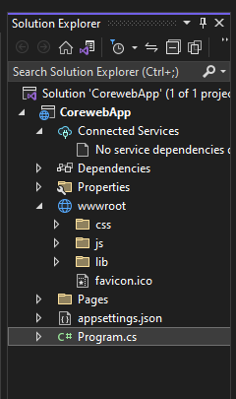
wwwroot
This is the webroot folder and all the static files required by the project are stored and served from here. The webroot folder contains a sub-folder to categorize the static file types, like all the Cascading Stylesheet files, are stored in the CSS folder, all the javascript files are stored in the js folder and the external libraries like bootstrap, jquery are kept in the library folder.
Generally, there should be separate folders for the different types of static files such as JavaScript, CSS, Images, library scripts, etc.
Notes:
wwwroot folder
This is the webroot folder and all the static files required by the project are stored and served from here. The webroot folder contains a sub-folder to categorize the static file types, like all the Cascading Stylesheet files, are stored in the CSS folder, all the javascript files are stored in the js folder and the external libraries like bootstrap, jquery are kept in the library folder.
Generally, there should be separate folders for the different types of static files such as JavaScript, CSS, Images, library scripts, etc.

Slide 23
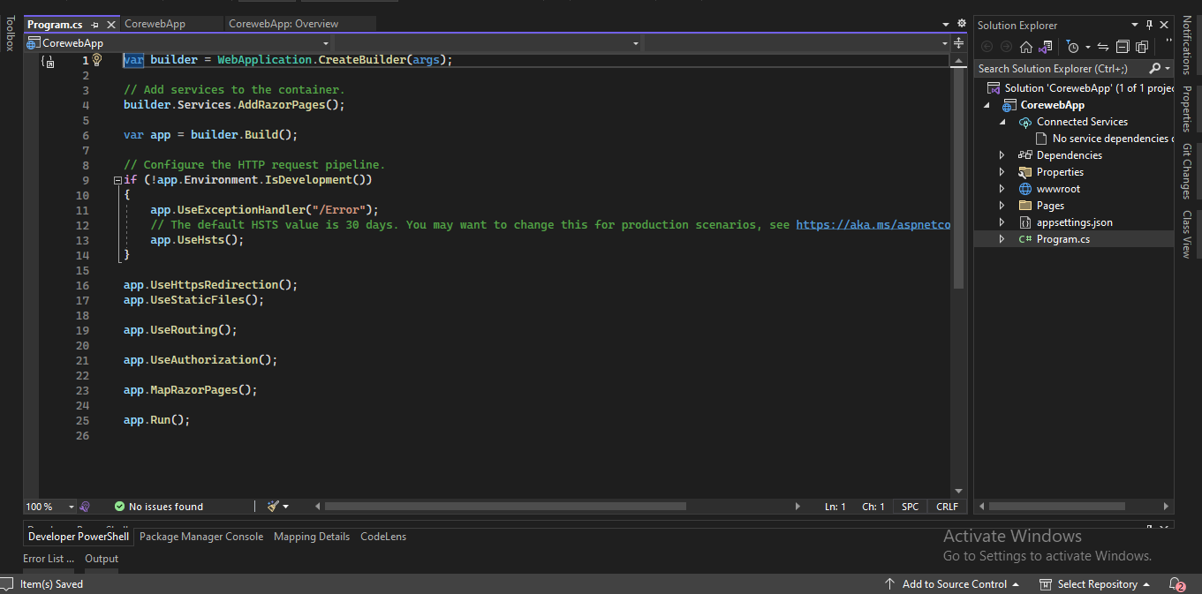
program.cs
This class is the entry point of the web application. It builts the host and executes the run method.
Notes:
program.cs
In an ASP.NET Core project, the Program.cs file is the entry point and orchestrator of the application. The Program.cs file is a C# file that contains a Main method, which is the starting point of the application. The Program.cs file also contains logic to start the server, listen for requests, and configure the application.

Slide 24
Thank you

